Slide 1
January 31, 2022
OCT IOI Performance
Owner
Tech Financial Ops Team, Louis A. Boney, Ryan Nishimoto, The Data Squad

Slide 2

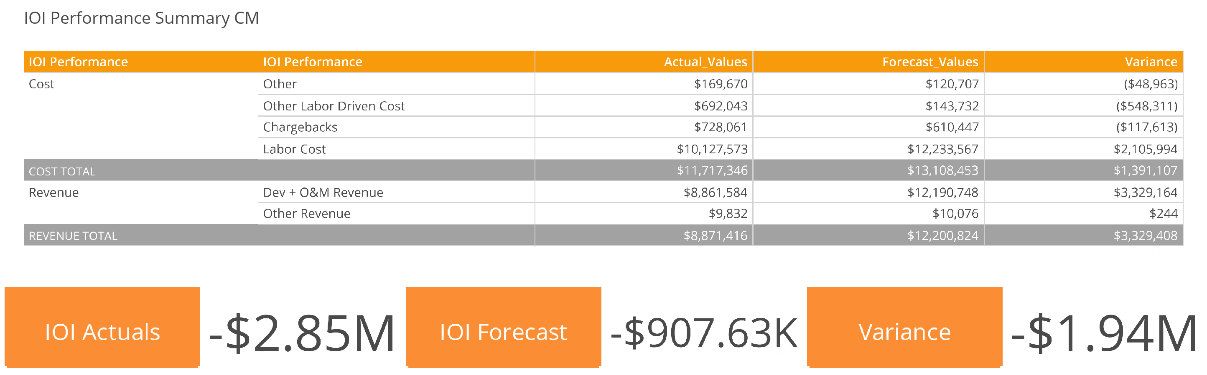

Slide 3
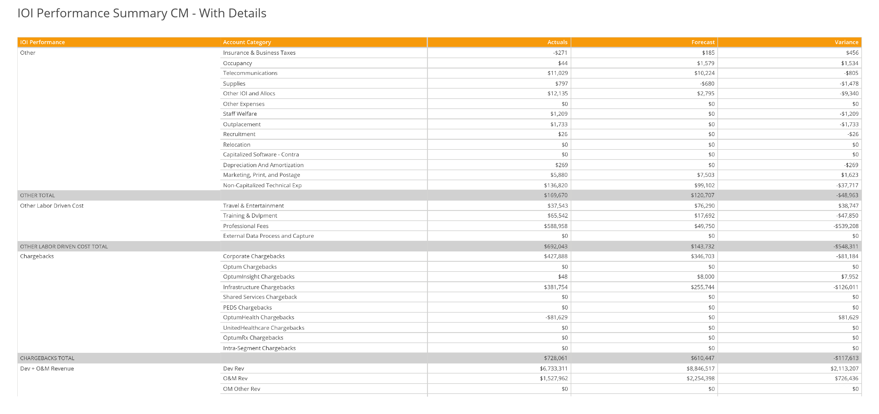

Slide 4
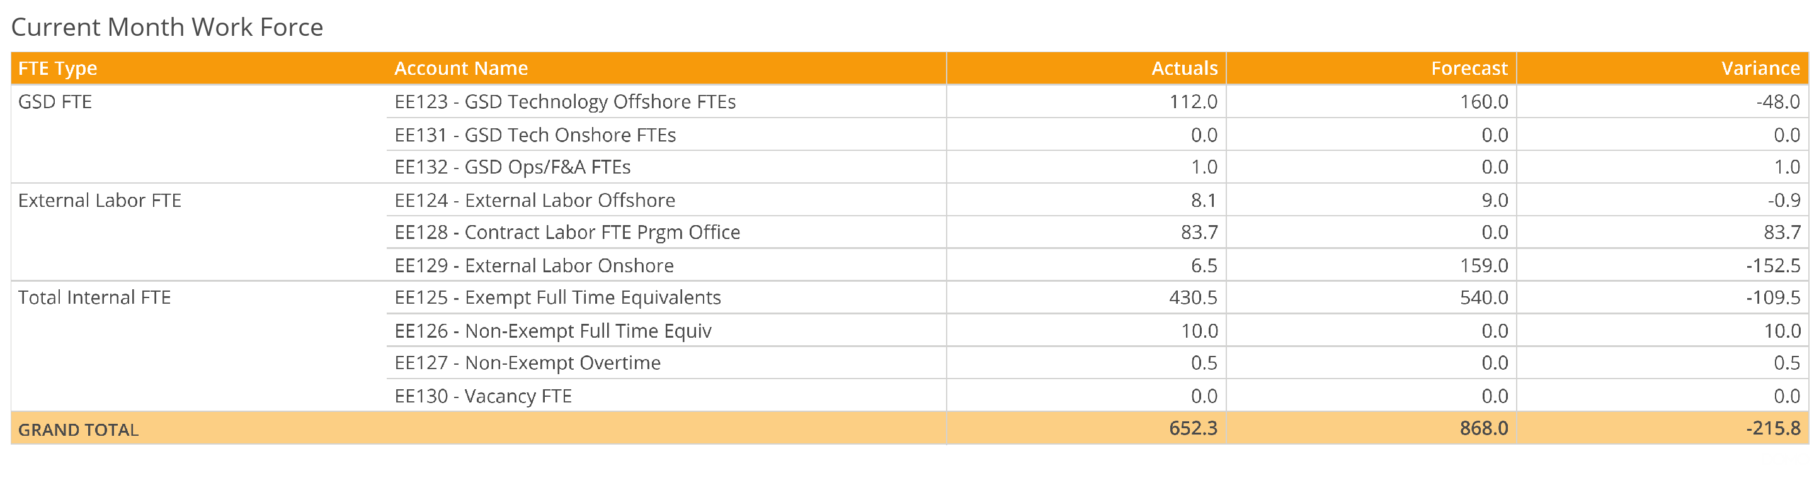

Slide 6
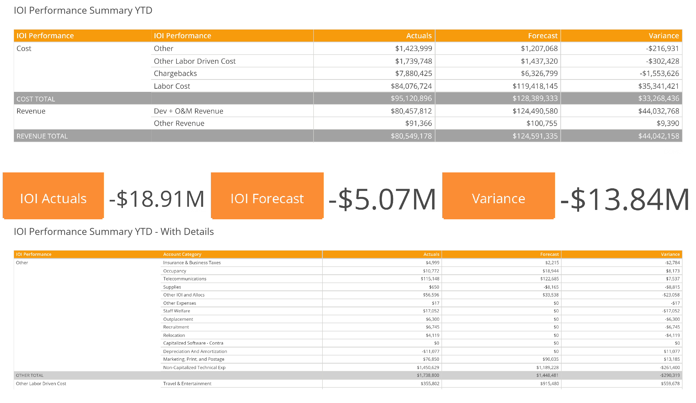

Slide 7
